Slide 1
INFORMATION SYSTEMS IN HEALTH CARE
Presentation of projects

Slide 2
Requirements

Slide 3
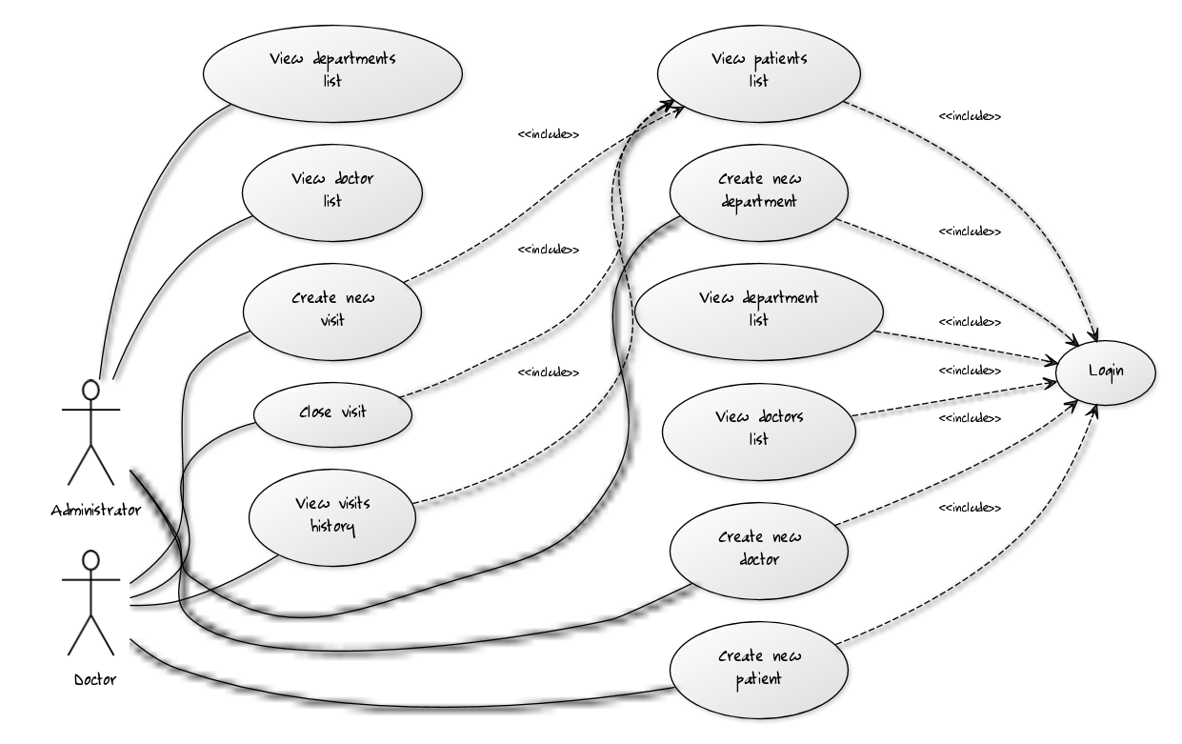
Adminstrator
log into the system
create new department
create new doctor
view doctor list
view departments list
Doctor
log into the system
create new patient
create new visit
close visit
view patient list
view visit history

Slide 4
Part I: Analysis

Slide 5
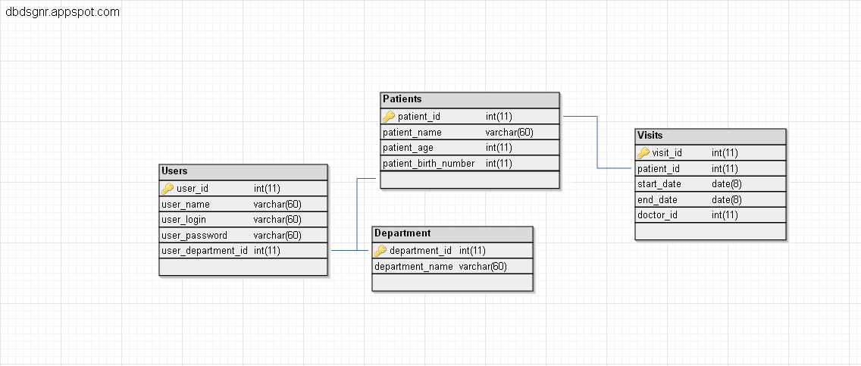
Databaze

Slide 6
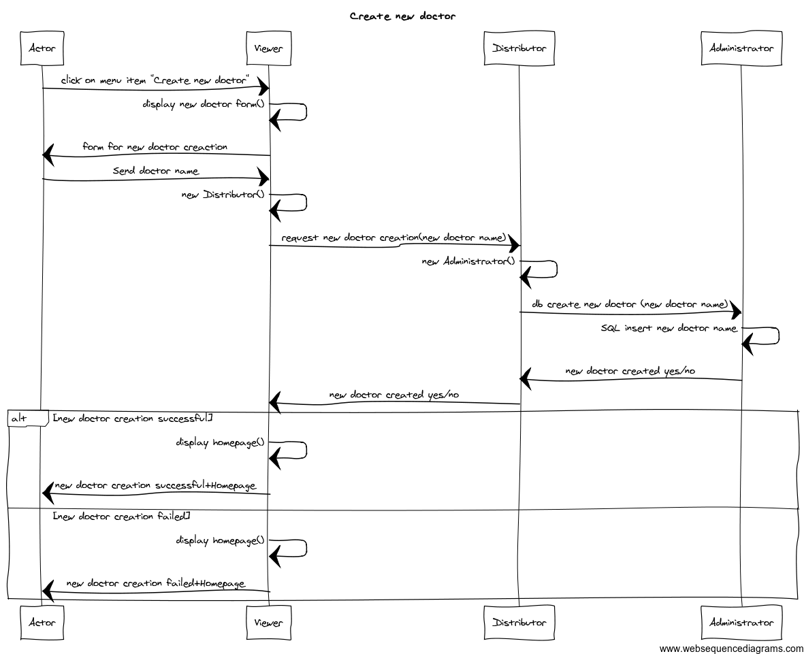
UML sequence diagram
Create new doctor

Slide 7
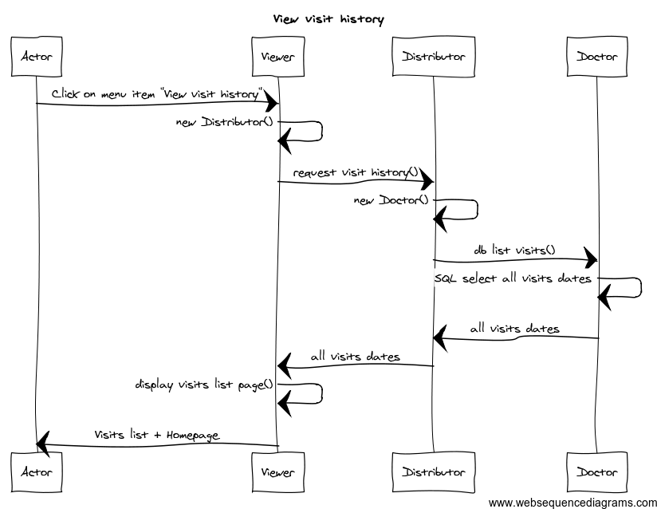
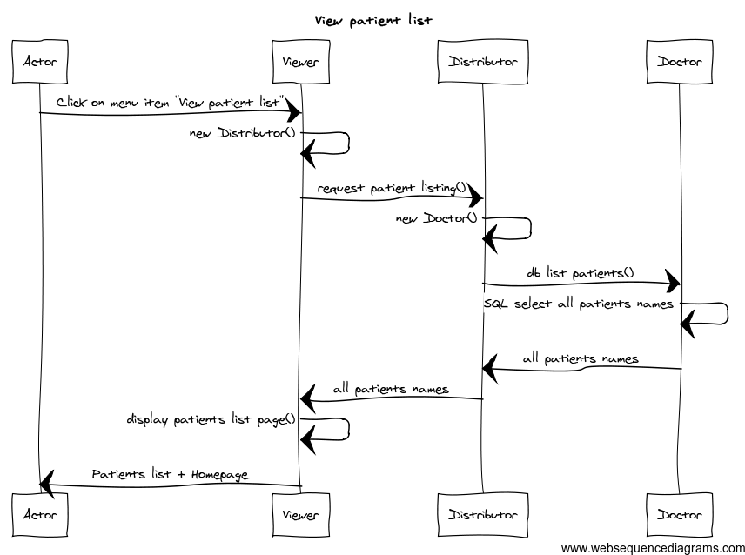
View patient list View visit history

Slide 8
Part II: Coding

Slide 9
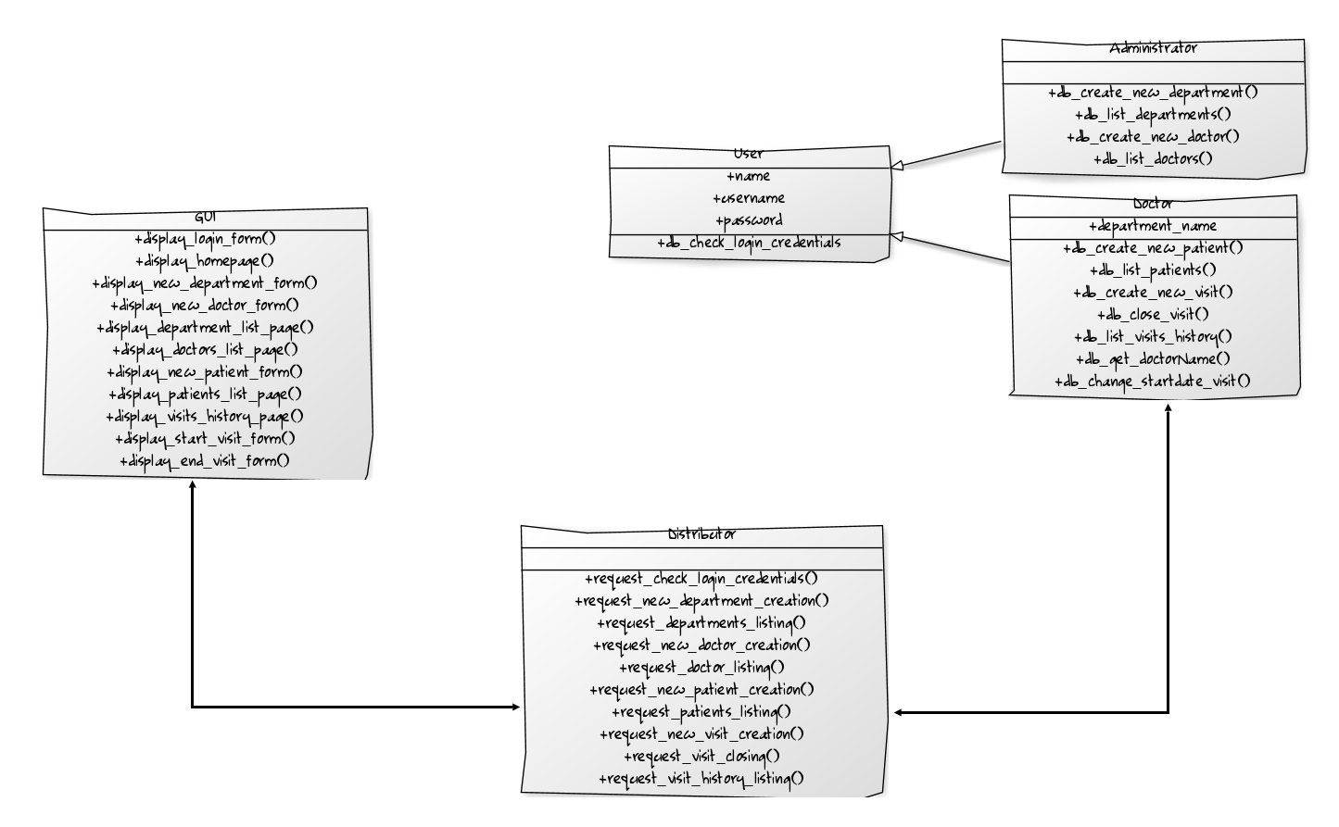

Slide 10
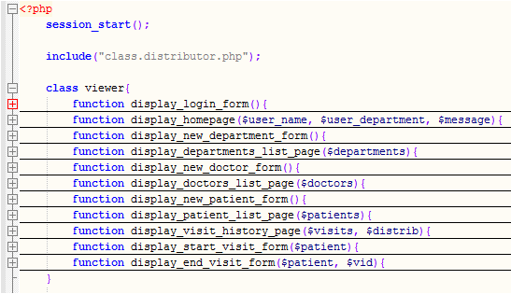
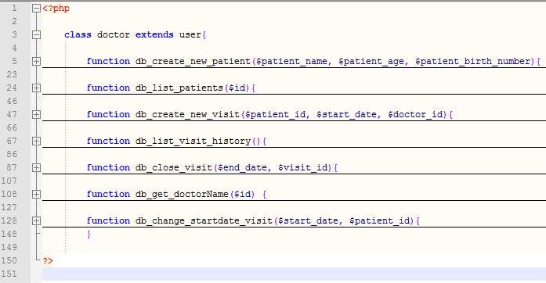
class.viewer
class.doctor

Slide 11
Part III: Testing

Slide 12



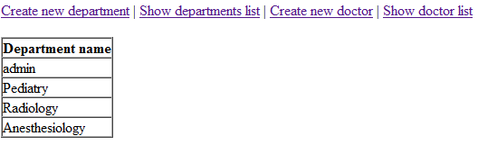
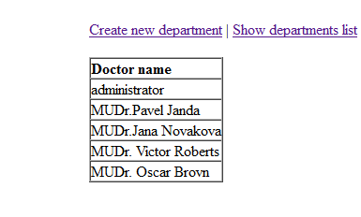
Login form Homepage – admin Homepage - doctor
Show doctor name
Show department name

Slide 13

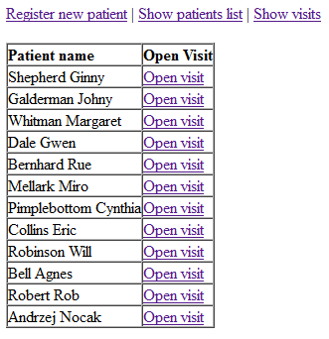
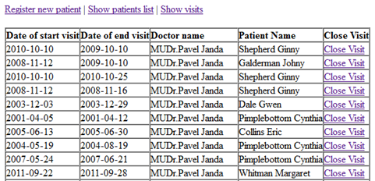
Register new patient Show patients list Show visits

Slide 14
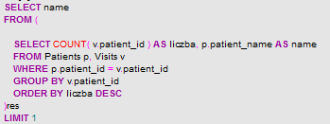

SQL queries for searching the following information:
Name of the patient with the greatest number of visits
SELECT name from (SELECT COUNT( v.patient_id ) as liczba, p.patient_name as name
FROM Patients p, Visits v
WHERE p.patient_id = v.patient_id
GROUP BY v.patient_id
ORDER BY liczba DESC) res
LIMIT 1

Slide 15


Name of the doctor who was assigned to the patient with the longest visit duration
SELECT user_name Doctor_Name, MAX(end_date - start_date) as NAZWA from Visits v, user u
WHERE end_date is not null
AND end_date > start_date and u.user_id = v.doctor_id
GROUP BY v.visit_id
ORDER BY NAZWA desc
LIMIT 1

Slide 16
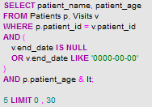

List of patients who are currently hospitalized and are younger than 5 years old
SELECT patient_name, patient_age from Patients p, Visits v
WHERE p.patient_id = v.patient_id and
(v.end_date is null or v.end_date like '0000-00-00') and p.patient_age < 5

